Slide 1
Course Code: MCP540-1 Course: Operating Systems Lab with Linux System Administration L: 0 Hrs., T: 0 Hrs., P:2 Hrs., Per week Total Credits: 1

Slide 2
Course Objectives
1.To know the basics of operating systems.
2.Introduction of the Linux operating system.
3.To learn how OS concepts in Linux.
Course Outcomes
On successful completion of the course, students will be able to:
1.Install and work with various operating systems.
2.Use and run the commands of Linux.
3.Implement OS concepts in LINUX.

Slide 3
Syllabus
Minimum 4 practicals and assignments based on but not limited to the following topics:
•Introduction to virtualization. Preparing Multiboot systems.
•Creating Linux Virtual machines (or any variant eg Fedora / ubuntu / Kalilinux).
•Introduction to Linux/Unix/ Windows Operating Systems.
•Studying file system of Linux.
•Compiling and executing C programs in Linux environment.
•Implementing OS concepts in Linux.

Slide 4
https://www.javatpoint.com/linux-file-system
https://studylib.net/doc/25237241/linux-lab-manual
https://ncet.co.in/assets/pdf/e_learning/cse/le/semV/pdf/OS-Lab-Manual.pdf

Slide 5
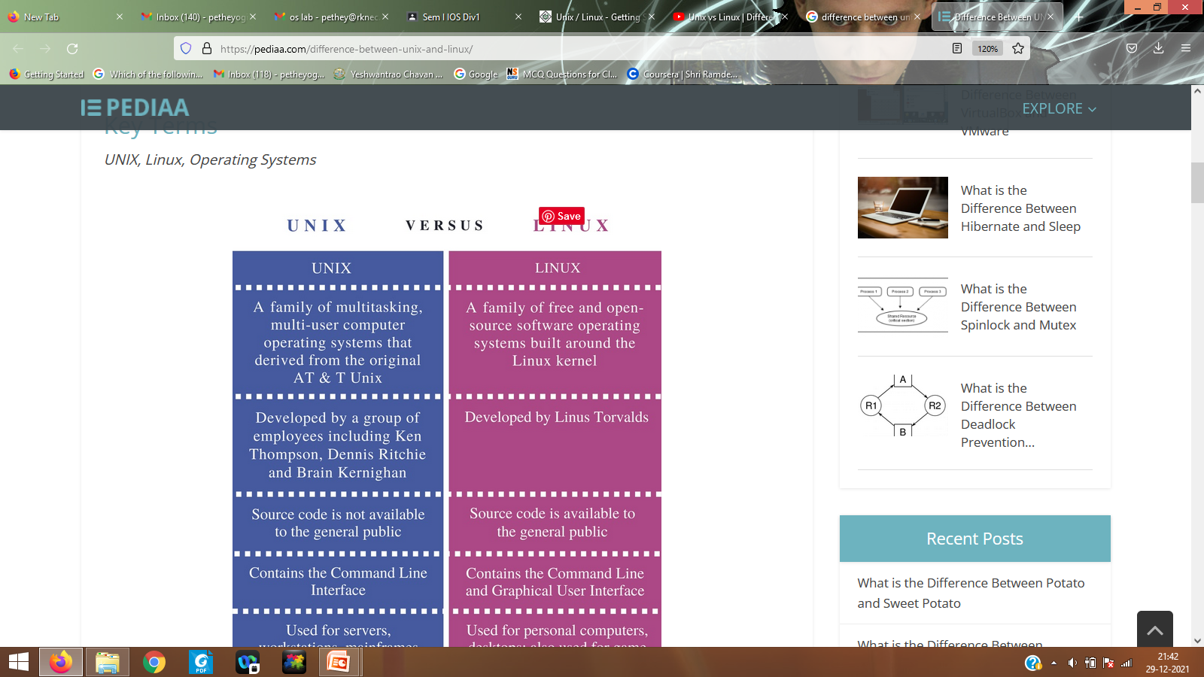

Slide 6
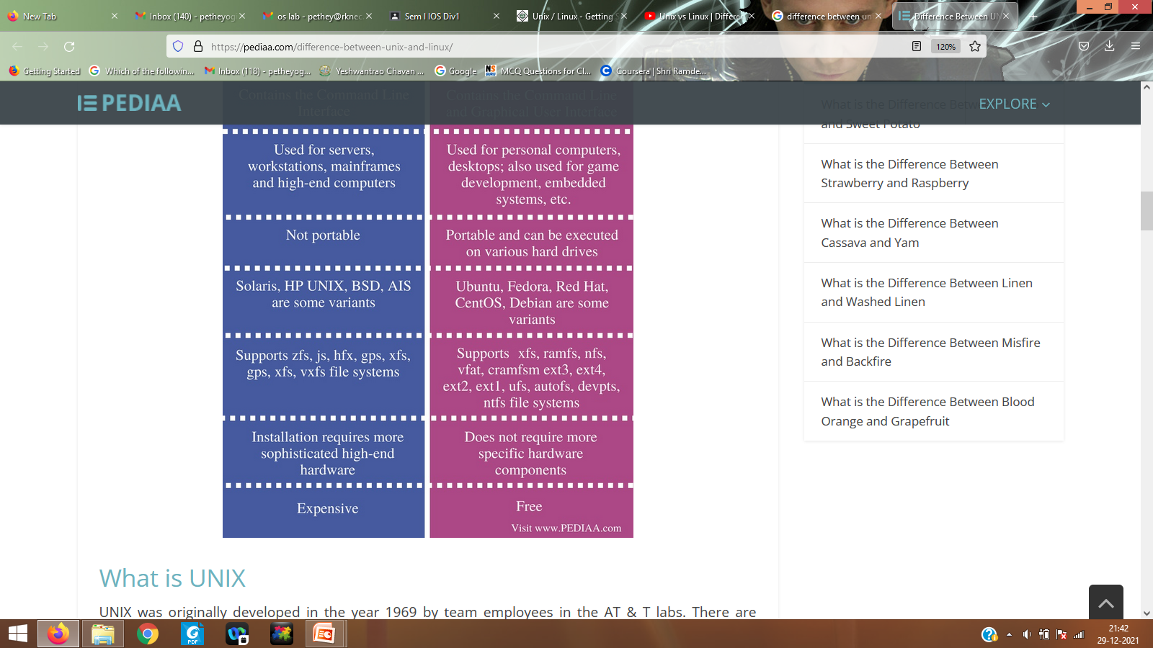

Slide 7
What is Windows Operating System?
The first version of Windows OS is released in 1985, which is a simple GUI, an extension of the existing disk operating system (MS-DOS) and major release.
From my perspective, the 1995 consumer release has integrated windows and DOS with built-in internet support.
Most of the PC is currently running on the Windows operating system only.
The latest Windows OS version is Windows 10, which is currently ruling the market.

Slide 8
What is a Linux Operating System?
Linux is an open-source operating system based on UNIX, created in 1991.
Linux operating system also comes with a graphical user interface (GUI) with some necessary software that are used daily.
It is also used in desktop computers, mobile devices, gaming consoles, digital storing devices, eBook readers, cameras, and video recorders with Linux running.

Slide 9
Key Differences Between Linux and Windows
Following is the Differences Between Linux and Windows:
Linux is an open-source operating system, whereas Windows OS is commercial.
Linux has access to source code and alters the code as per user need, whereas Windows does not have access to source code.
Linux will run faster than windows latest editions, even with a modern desktop environment and features of the operating system, whereas windows are slow on older hardware.
Linux distributions don’t collect user data, whereas Windows collects all the user details, which leads to privacy concern.
Linux is more reliable then windows as in Linux, we can kill application if they hung through the x kill command, whereas, in windows, we need to try multiple times to kill it.
Linux supports a wide variety of free software’s than windows, but windows have a large collection of video game software.
In Linux software, the cost is almost free as all programs, utilities, complex applications such as open office are free, but windows also have many free programs and utilities, but most of the programs are commercial.
Linux is highly secure because it’s easy to identify bugs and fix, whereas Windows has a large user base and becomes a target for developers of viruses and malware.
Corporate organizations use Linux as servers and operating system for security purpose at Google, Facebook, Twitter etc., whereas gamers and business users mostly use windows.
Linux and windows have the same priority over hardware and driver support in the present situation.

Slide 10
Linux and Windows Comparison
Access
In Linux, the user has access to the source code of the kernel and alter the code according to his need. It has its own advantages, like bugs in OS will fix at a rapid pace and disadvantages like developers may take advantage of any weakness in OS if they found.
In windows, every user won’t have access to the source code; only members of the selected group will have access to it.
Flavors or Variety
Linux has various distributions which are highly customizable based on user needs. Windows has very few customization options available.
Licensing In Linux with GPL- Licensed operating system, users are free to modify the software, can re-use in any number of systems and even they can sell the modified version. In windows, with a Microsoft license, users won’t have access to source code (can’t modify the software) and based on a number of licenses – we can install only on those number of computers.
Command-line In Linux, the command line is a very useful tool for administration and daily tasks but for end-users, it doesn’t make much difference. In windows, we have a command line but can’t use a Linux command line. We need to go running and enter cmd then the command line will open.

Slide 11
Linux and Windows Comparison
Run level Linux has an inbuilt ability to stop at different run levels; with this, we can work using a command line and GUI if anyone has an issue. In windows, if we encounter any problem in order to fix it, we need to reboot at run level 3 as an administrator/ root to find and fix the problem.
Usability Linux is complicated to install but has the ability to complete complex tasks easier. Windows gives user’s a simple system to operate, but it will take a longer time to install.
Support Linux has support via a huge community of user forums/websites and online search. Windows has support that is easily accessible, online forums/ websites, and it has paid support also. Updates In Linux, users have full control of updates; we can install whenever we needed, and it will take less time without any reboot. In windows, updates will come at inconvenient times, such as you are giving a print to the printer but suddenly update pop up will come, which makes users frustrate and took more time to install.
Security Linux is more secure than windows, where hackers or developers of viruses will find it difficult to break through Linux. Windows is the major target for developers of viruses and malware, and it is most vulnerable without anti-virus software.

Slide 12
Linux File System
A Linux file system is a structured collection of files on a disk drive or a partition. A partition is a segment of memory and contains some specific data. In our machine, there can be various partitions of the memory. Generally, every partition contains a file system.
The general-purpose computer system needs to store data systematically so that we can easily access the files in less time. It stores the data on hard disks (HDD) or some equivalent storage type. There may be below reasons for maintaining the file system:
Primarily the computer saves data to the RAM storage; it may lose the data if it gets turned off. However, there is non-volatile RAM (Flash RAM and SSD) that is available to maintain the data after the power interruption.
Data storage is preferred on hard drives as compared to standard RAM as RAM costs more than disk space. The hard disks costs are dropping gradually comparatively the RAM.

Slide 13
What is the Linux File System?
The Linux file system contains the following sections:
The root directory (/)
A specific data storage format (EXT3, EXT4, BTRFS, XFS and so on)
A partition or logical volume having a particular file system.
Linux file system is generally a built-in layer of a Linux operating system
used to handle the data management of the storage. It helps to arrange the file on the disk storage. It manages the file name, file size, creation date, and much more information about a file.

Slide 14
Linux File System Structure
Linux file system has a hierarchal file structure as it contains a root directory and its subdirectories. All other directories can be accessed from the root directory. A partition usually has only one file system, but it may have more than one file system.
A file system is designed in a way so that it can manage and provide space for non-volatile storage data. All file systems required a namespace that is a naming and organizational methodology. The namespace defines the naming process, length of the file name, or a subset of characters that can be used for the file name. It also defines the logical structure of files on a memory segment, such as the use of directories for organizing the specific files. Once a namespace is described, a Metadata description must be defined for that particular file.
The data structure needs to support a hierarchical directory structure; this structure is used to describe the available and used disk space for a particular block. It also has the other details about the files such as file size, date & time of creation, update, and last modified.
Also, it stores advanced information about the section of the disk, such as partitions and volumes.
The advanced data and the structures that it represents contain the information about the file system stored on the drive; it is distinct and independent of the file system metadata.

Slide 15
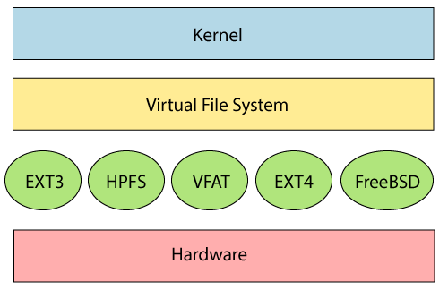

Slide 16
The file system requires an API (Application programming interface) to access the function calls to interact with file system components like files and directories. API
facilitates tasks such as creating, deleting, and copying the files. It facilitates an algorithm that defines the arrangement of files on a file system.
The first two parts of the given file system together called a Linux virtual file system. It provides a single set of commands for the kernel and developers to access the file system. This virtual file system requires the specific system driver to give an interface to the file system.

Slide 17
Linux File System Features
In Linux, the file system creates a tree structure. All the files are arranged as a tree and its branches. The topmost directory called the root (/) directory. All other directories in Linux can be accessed from the root directory.
Some key features of Linux
file system are as following:
Specifying paths: Linux does not use the backslash (\) to separate the components; it uses forward slash (/) as an alternative. For example, as in Windows, the data may be stored in C:\ My Documents\ Work, whereas, in Linux, it would be stored in /home/ My Document/ Work.
Partition, Directories, and Drives: Linux does not use drive letters to organize the drive as Windows does. In Linux, we cannot tell whether we are addressing a partition, a network device, or an "ordinary" directory and a Drive.

Slide 18
Linux File System Features
Case Sensitivity: Linux file system is case sensitive. It distinguishes between lowercase and uppercase file names. Such as, there is a difference between test.txt and Test.txt in Linux. This rule is also applied for directories and Linux commands.
File Extensions: In Linux, a file may have the extension '.txt,' but it is not necessary that a file should have a file extension. While working with Shell, it creates some problems for the beginners to differentiate between files and directories. If we use the graphical file manager, it symbolizes the files and folders.
Hidden files: Linux distinguishes between standard files and hidden files, mostly the configuration files are hidden in Linux OS. Usually, we don't need to access or read the hidden files. The hidden files in Linux are represented by a dot (.) before the file name (e.g., .ignore). To access the files, we need to change the view in the file manager or need to use a specific command in the shell.

Slide 19
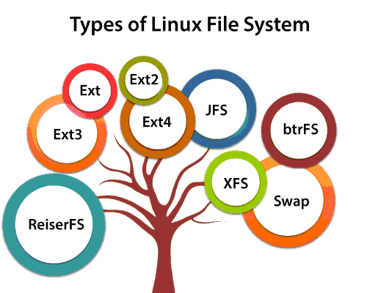
Types of Linux File System
When we install the Linux operating system, Linux offers many file systems such as Ext, Ext2, Ext3, Ext4, JFS, ReiserFS, XFS, btrfs, and swap.

Slide 20
Types of Linux File System
1. Ext, Ext2, Ext3 and Ext4 file system
The file system Ext stands for Extended File System. It was primarily developed for MINIX OS. The Ext file system is an older version, and is no longer used due to some limitations.
Ext2 is the first Linux file system that allows managing two terabytes of data. Ext3 is developed through Ext2; it is an upgraded version of Ext2 and contains backward compatibility. The major drawback of Ext3 is that it does not support servers because this file system does not support file recovery and disk snapshot.
Ext4 file system is the faster file system among all the Ext file systems. It is a very compatible option for the SSD (solid-state drive) disks, and it is the default file system in Linux distribution.

Slide 21
Types of Linux File System
2. JFS File System
JFS stands for Journaled File System, and it is developed by IBM for AIX Unix. It is an alternative to the Ext file system. It can also be used in place of Ext4, where stability is needed with few resources. It is a handy file system when CPU power is limited.
3. ReiserFS File System
ReiserFS is an alternative to the Ext3 file system. It has improved performance and advanced features. In the earlier time, the ReiserFS was used as the default file system in SUSE Linux, but later it has changed some policies, so SUSE returned to Ext3. This file system dynamically supports the file extension, but it has some drawbacks in performance.

Slide 22
Types of Linux File System
4. XFS File System
XFS file system was considered as high-speed JFS, which is developed for parallel I/O processing. NASA still using this file system with its high storage server (300+ Terabyte server).
5. Btrfs File System
Btrfs stands for the B tree file system. It is used for fault tolerance, repair system, fun administration, extensive storage configuration, and more. It is not a good suit for the production system.
6. Swap File System
The swap file system is used for memory paging in Linux operating system during the system hibernation. A system that never goes in hibernate state is required to have swap space equal to its RAM size.

Slide 23
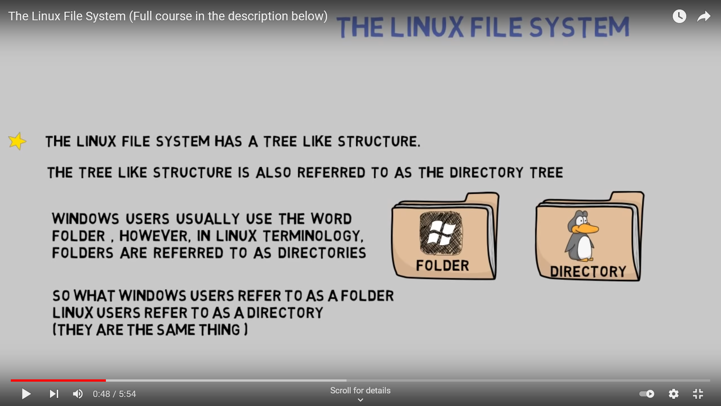
THE LINUX FILE SYSTEM

Slide 24
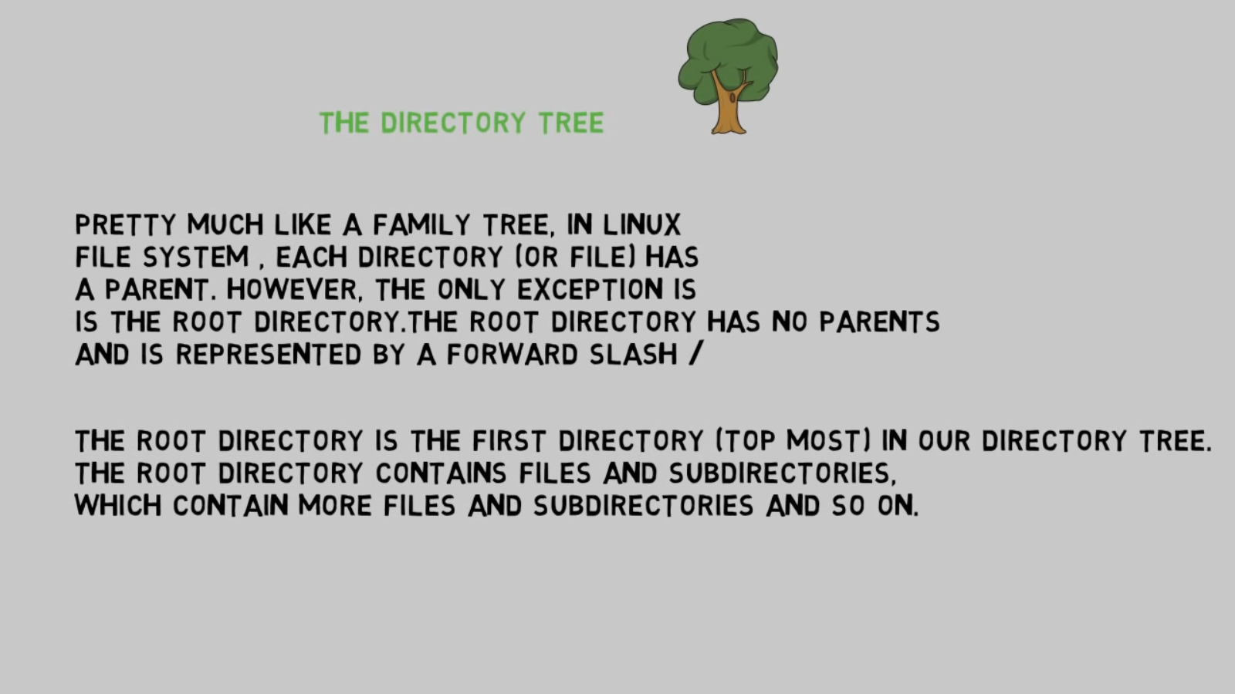

Slide 25
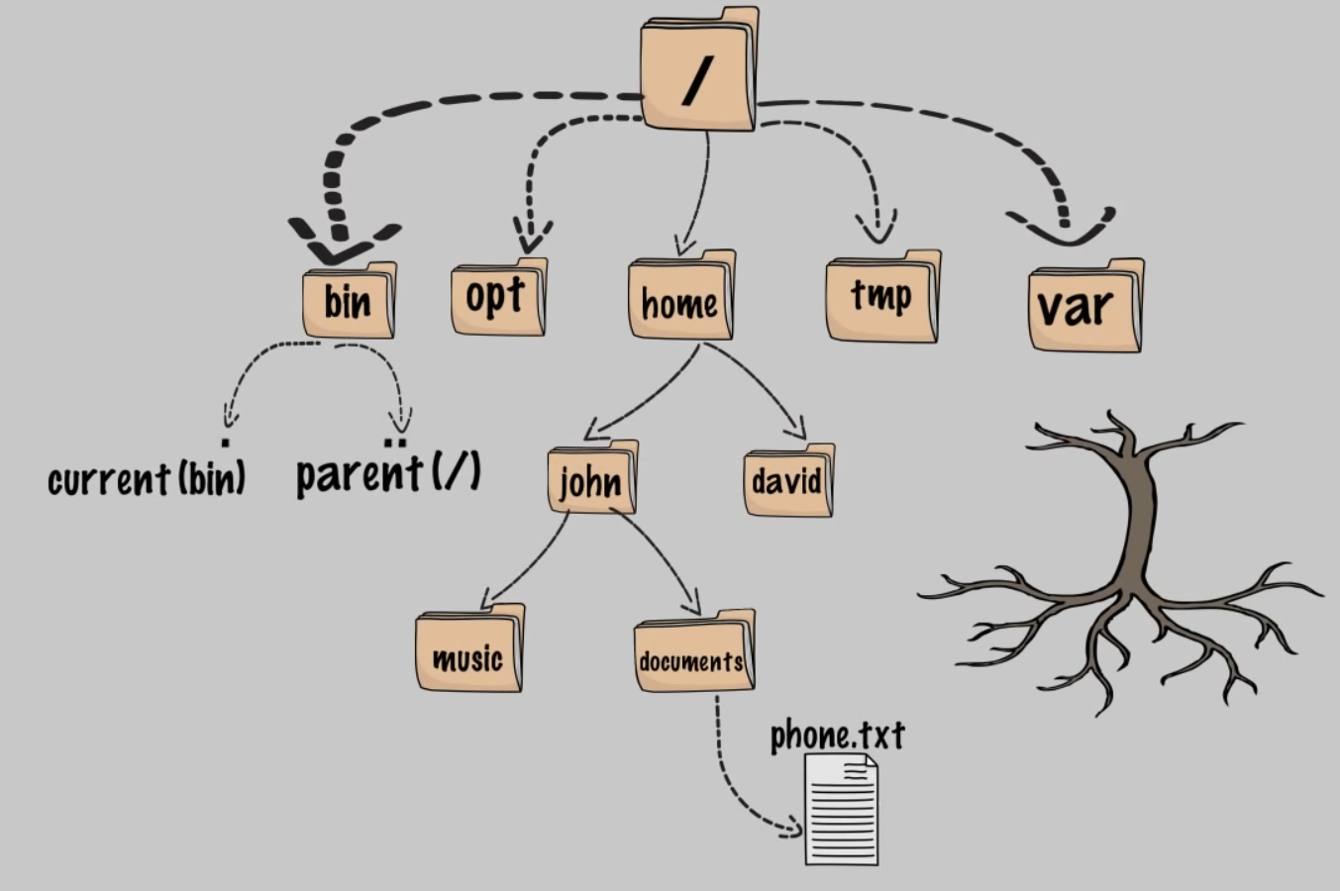

Slide 26


Slide 27
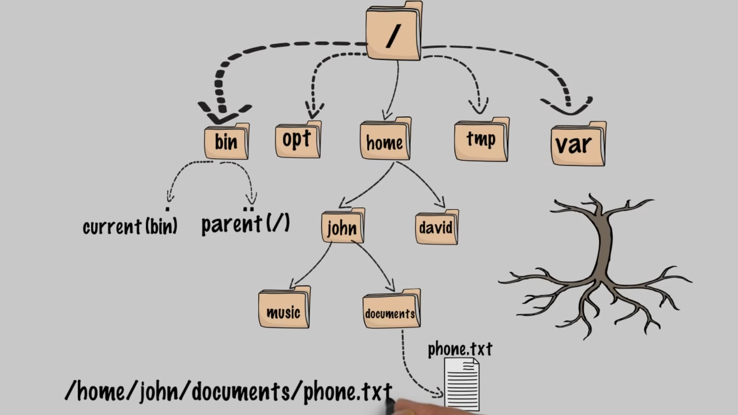

Slide 28
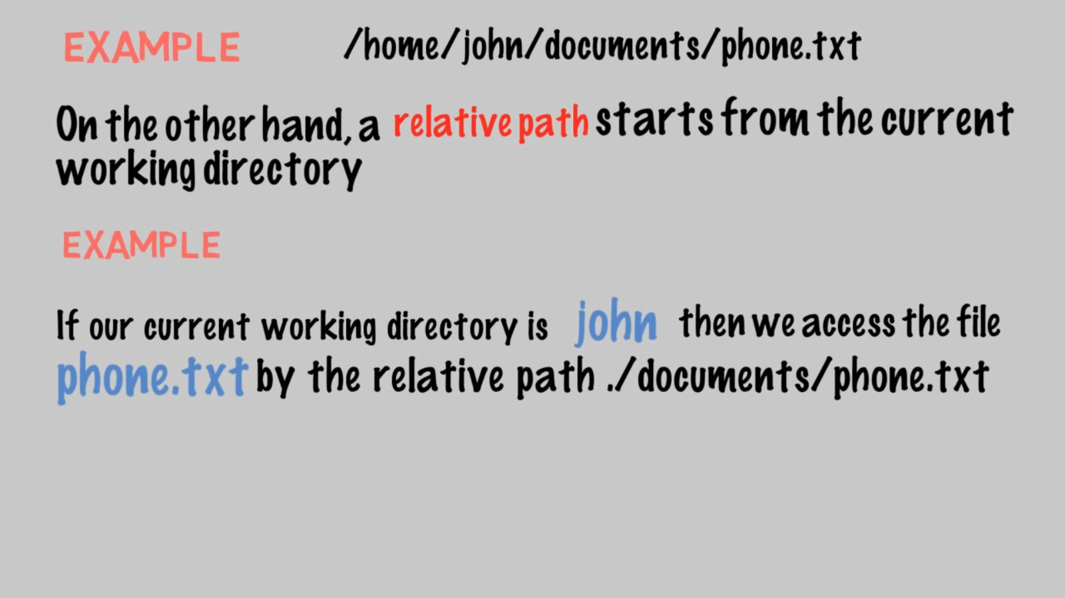

Slide 29
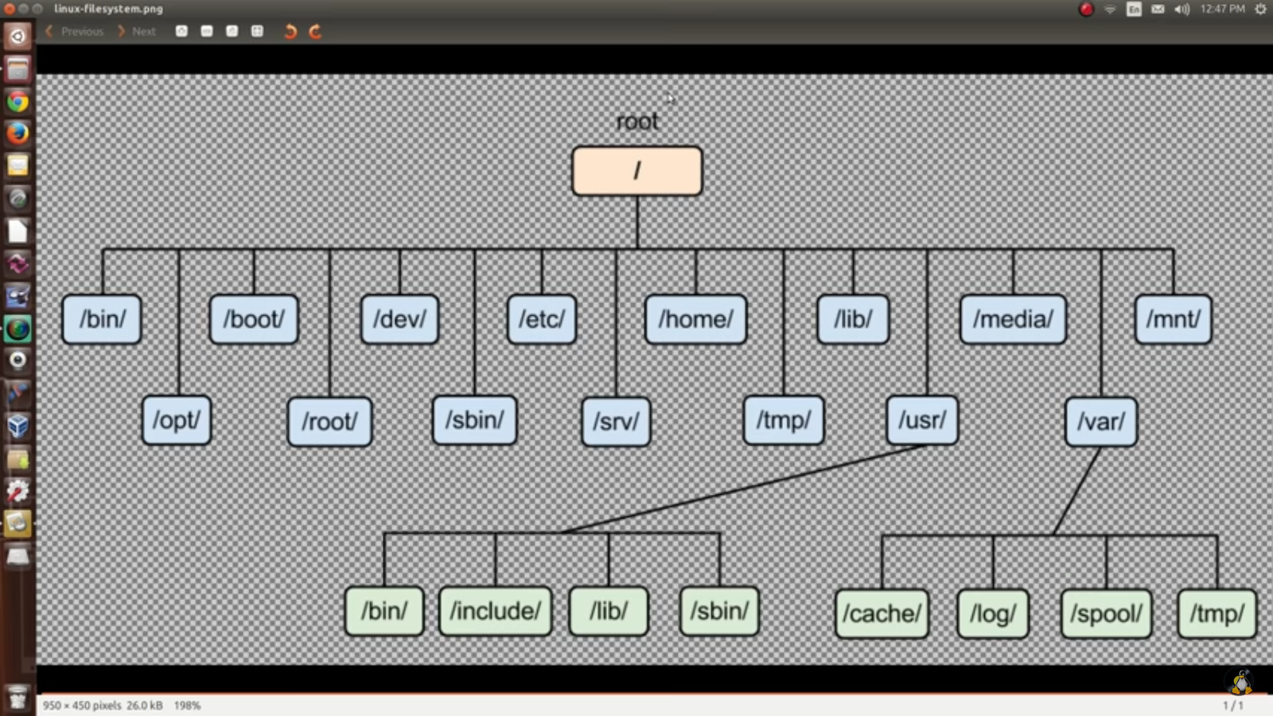

Slide 30
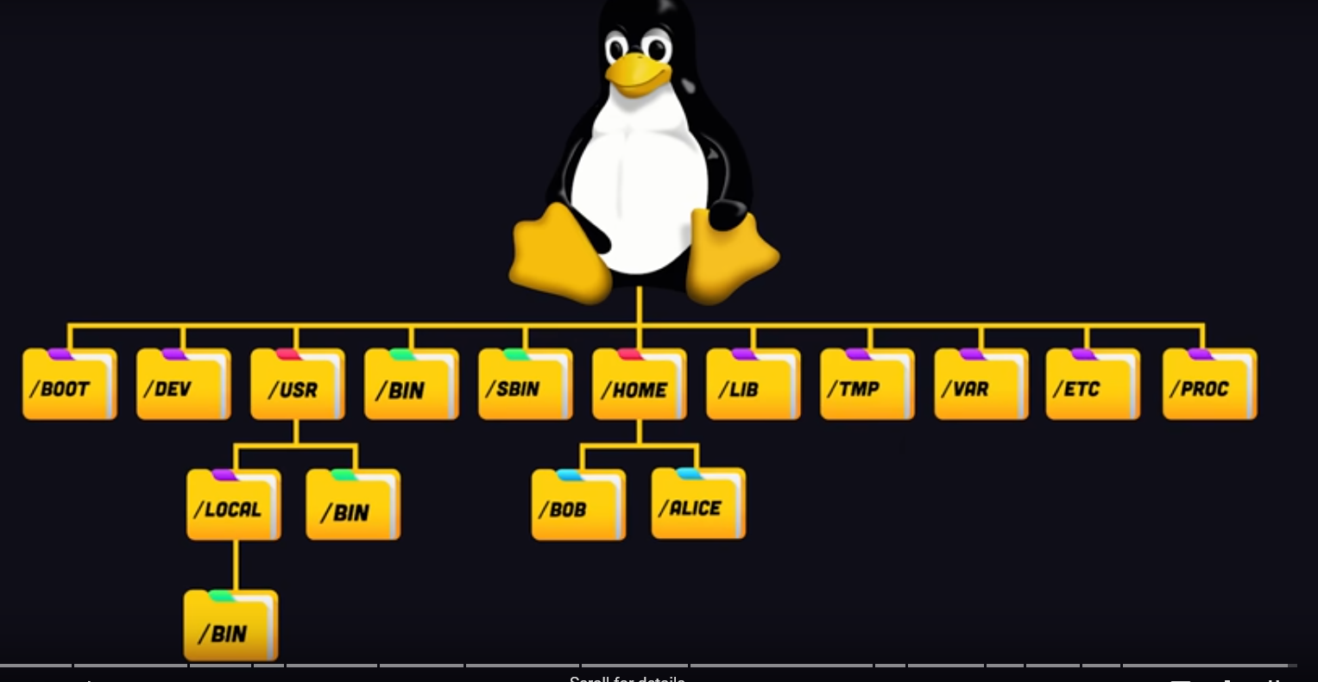

Slide 31
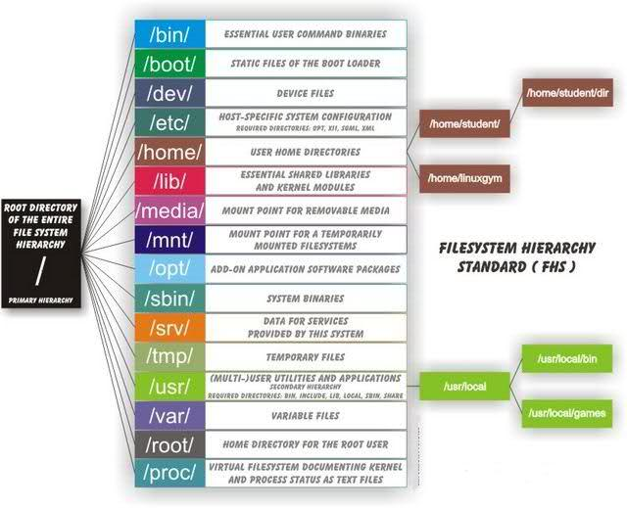
Linux Directory Structure Diagram

Slide 32
Each of the above directory (which is a file, at the first place) contains important information, required for booting to device drivers, configuration files, etc. Describing briefly the purpose of each directory, we are starting hierarchically.
/bin : All the executable binary programs (file) required during booting, repairing, files required to run into single-user-mode, and other important, basic commands viz., cat, du, df, tar, rpm, wc, history, etc.
/boot : Holds important files during boot-up process, including Linux Kernel.
/dev : Contains device files for all the hardware devices on the machine e.g., cdrom, cpu, etc
/etc : Contains Application’s configuration files, startup, shutdown, start, stop script for every individual program.
/home : Home directory of the users. Every time a new user is created, a directory in the name of user is created within home directory which contains other directories like Desktop, Downloads, Documents, etc.
/lib : The Lib directory contains kernel modules and shared library images required to boot the system and run commands in root file system.
/lost+found : This Directory is installed during installation of Linux, useful for recovering files which may be broken due to unexpected shut-down.

Slide 33
/media : Temporary mount directory is created for removable devices viz., media/cdrom.
/mnt : Temporary mount directory for mounting file system.
/opt : Optional is abbreviated as opt. Contains third party application software. Viz., Java, etc.
/proc : A virtual and pseudo file-system which contains information about running process with a particular Process-id aka pid.
/root : This is the home directory of root user and should never be confused with ‘/‘
/run : This directory is the only clean solution for early-runtime-dir problem.

Slide 34
/sbin : Contains binary executable programs, required by System Administrator, for Maintenance. Viz., iptables, fdisk, ifconfig, swapon, reboot, etc.
/srv : Service is abbreviated as ‘srv‘. This directory contains server specific and service related files.
/sys : Modern Linux distributions include a /sys directory as a virtual filesystem, which stores and allows modification of the devices connected to the system.
/tmp :System’s Temporary Directory, Accessible by users and root. Stores temporary files for user and system, till next boot.
/usr : Contains executable binaries, documentation, source code, libraries for second level program.
/var : Stands for variable. The contents of this file is expected to grow. This directory contains log, lock, spool, mail and temp files.

Slide 35
Virtualization
Virtualization is the process of running a virtual instance of a computer system in a layer abstracted from the actual hardware.
Most commonly, it refers to running multiple operating systems on a computer system simultaneously.
To the applications running on top of the virtualized machine, it can appear as if they are on their own dedicated machine, where the operating system, libraries, and other programs are unique to the guest virtualized system and unconnected to the host operating system which sits below it.
There are many reasons why people utilize virtualization in computing.
To desktop users, the most common use is to be able to run applications meant for a different operating system without having to switch computers or reboot into a different system.

Slide 36
Virtualization
For administrators of servers, virtualization also offers the ability to run different operating systems, but perhaps, more importantly, it offers a way to segment a large system into many smaller parts, allowing the server to be used more efficiently by a number of different users or applications with different needs.
It also allows for isolation, keeping programs running inside of a virtual machine safe from the processes taking place in another virtual machine on the same host.
Virtualization is technology that lets you create useful IT services
using resources that are traditionally bound to hardware. It allows you
to use a physical machine’s full capacity by distributing its capabilities
among many users or environments.

